Slide 1

IOT based smart wearable safety gadget
Group-7
Amandeep Kaur(748434)

Slide 2
Interfacing of ESP32-CAM with LPC2148

Slide 3
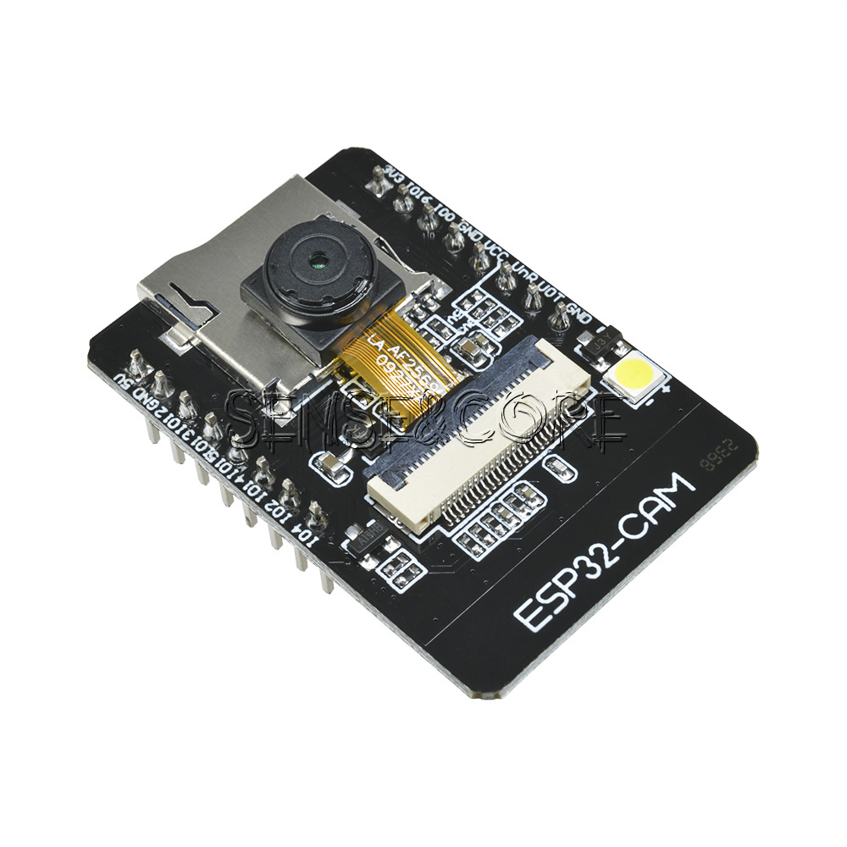
ESP32-CAM
Small camera module.
Integrated micro SD card socket.
Cost effective.
Nine GPIO pins.
Flash LED.

Slide 4
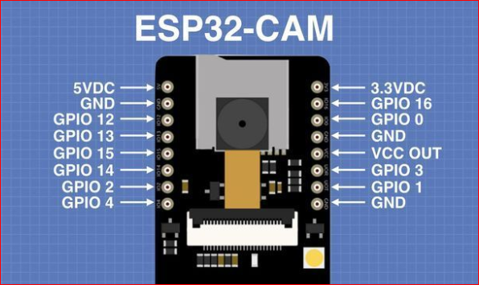
Pin diagram of Esp32-cam

Slide 5
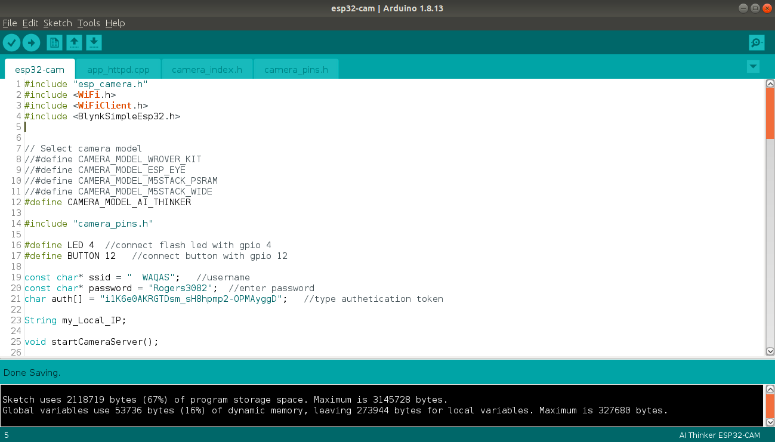

Slide 6
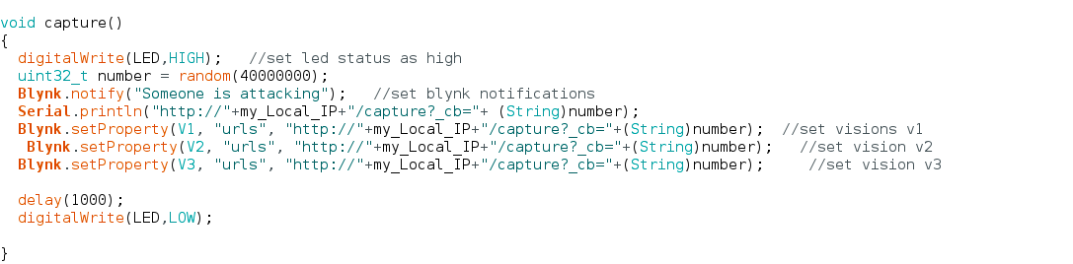

Slide 7
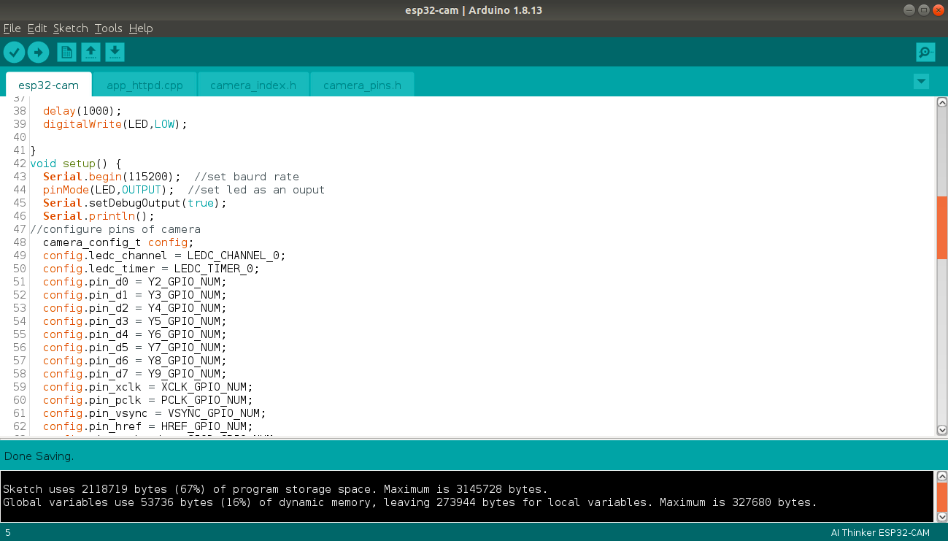

Slide 8
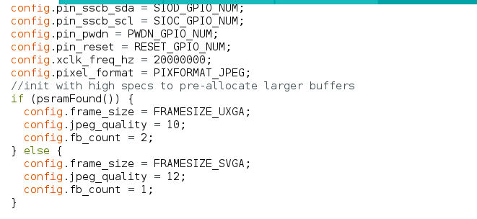

Slide 9
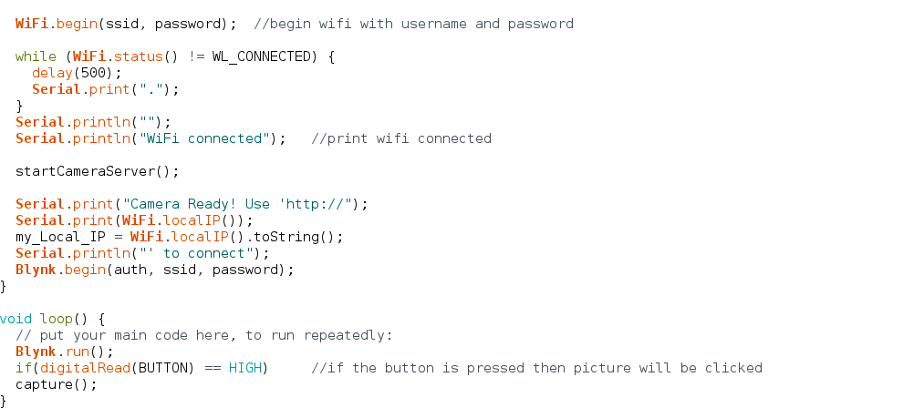

Slide 10
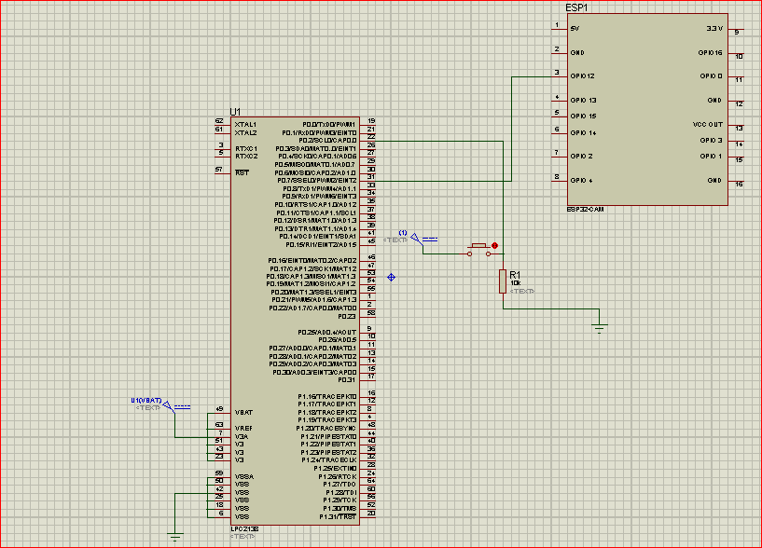
Schematic Design

Slide 11
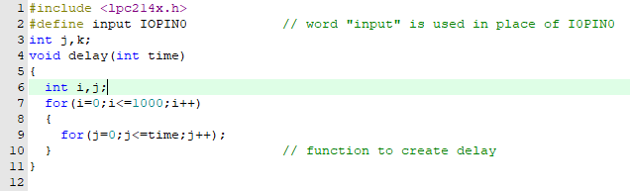
Coding

Slide 12
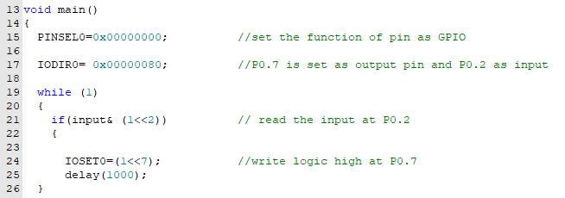
Continued

Slide 13
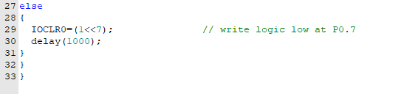
Continued…

Slide 14
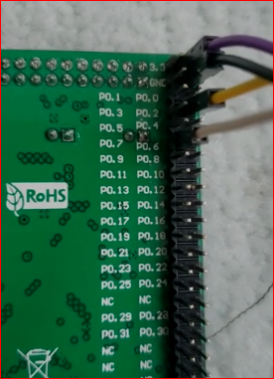
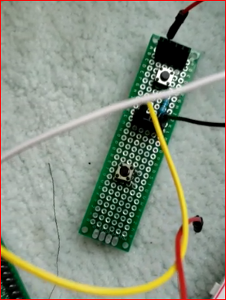
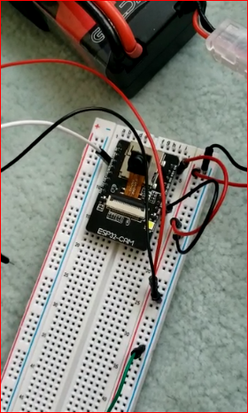
Hardware implementation

Slide 15
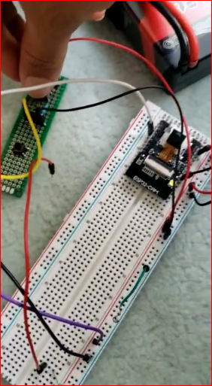
Results

Slide 16
Reference
Dronebot Workshop(2020).Getting started with ESP32-CAM. https://dronebotworkshop.com/esp32-cam-intro/
Randomnerd tutorial.(2020)ESP32-INTRODUCTION https://randomnerdtutorials.com/esp32-pinout-reference-gpios/’
Technisms.(2020).smart door bell using esp32cam,esp-eyeand blynk http://bit.ly/2Tba4Jt.
yana. M.K.Aishwarya, Nagamma.H., Chaithara.K.S. (2019),IOT based smart secuirty gadget for women’s safety, International Conference on Advance in Information Technology. https://ieeexplore.ieee.org/document/8987242

